Slide 1
HSC PDHPE
Cancer Council & OC Action Areas

Slide 2
TASK
You need to critically analyse the importance of the five action areas of the Ottawa Charter through a study of two health promotion initiatives related to Australia's health priorities. This presentation has a detailed breakdown of the Ottawa Charter in action in relation to the Cancer Council.

Slide 3
Building Healthy Public Policy

Slide 4
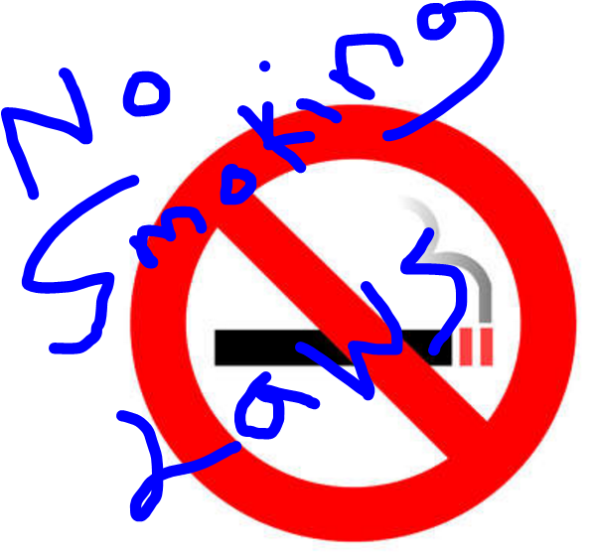
To protect health across the population irrespective of SES, rurality, race etc
AIM

Slide 5
Building Healthy Public Policies can be broken down in sub categories

Slide 6
Regulation e.g. laws preventing minors under 18 yrs purchasing alcohol and tobacco

Slide 7
Other regulations
* Proposals recently developed by Food Standards Australia New Zealand (FSANZ) for mandatory nutrition content of food labelling are aimed at enabling consumers to make informed choices about the foods they purchase and consume. (FSANZ is part of the Australian Government’s Health and Ageing portfolio).
* Legislating against junk-food advertising to children. This strategy is not about restricting choice; as well targeted multimillion-dollar advertising campaigns already create an imbalance in the choices that uninformed and often disadvantaged families see as being available to them.
* Smoke free legislation (workplaces, pubs and clubs etc) to prevent and reduce tobacco use and ensure workers are protected from second hand smoke exposure in their place of employment
* National OH&S legislation to protect workers from exposure to occupational carcinogens and UV exposure

Slide 8
Fiscal Measures
e.g. Medicare reimbursement
* Yearly Medicare funded ‘health checks’ for people over 45 yrs
* Government subsidised cancer drugs and treatments

Slide 9
Taxation
e.g. Tobacco, alcohol taxes
* Tobacco and alcohol taxation to reduce tobacco and alcohol use

Slide 10
Policy
* National breast and cervical cancer screening policies and programs
* Healthy school canteen policies and associated resources
* National HPV, Hepatitis B vaccination policies and programs
e.g. Vaccination / Screening programs

Slide 11
Evidence Based Practice
* Development, adherence to, and regular updating of, evidence based cancer management guidelines and best practice policies for health professionals to ensure the best care is provided on a consistent basis irrespective of the patients age, ethnicity, socioeconomic status, geographical location etc
e.g. clinical care guidelines, continuing professional development, cost effective interventions.

Slide 12
Create Supportive Environments
Aim: Generate living, playing and working conditions that support health and safety

Slide 13
Infrastructure
e.g. Women's health centres, walking paths, shade structures, libraries
* Vending machines with healthy food choices like low-fat milk, fruits and low-calorie snacks
* Public workout areas, playing and sporting fields, and other exercise opportunities
* Safe accessible pathways and cycle-ways that make the decision to walk or cycle for transport easier

Slide 14
Technology
e.g. Accessible and reliable Internet and broadband access
* Accessible specialist cancer diagnostic technology to allow early and accurate cancer detection

Slide 15
Services e.g. Free phone quit (smoking) service, Cancer Helpline, Free cancer telegroup counselling, interpreter and sign language services,
Telegroup Counselling is a free and confidential service of the Cancer Council NSW. This service offers emotional support and advice through talking with others who are going through a similar experience. Unlike traditional support groups, telegroups get together over the phone. Telegroup counselling provides an option for people living in remote areas and for those who are socially isolated.
The Multicultural Cancer Information Service (MCIS) of the Cancer Council NSW offers a free confidential telephone and information and support service in a range of community languages for people with cancer and their carers on all issues related to cancer - Arabic, Cantonese, Greek, Italian, Chinese, Mandarin languages are available. The MCIS team also provides assistance to language specific cancer support groups throughout NSW and support other Cancer Council staff in program planning and pathways of implementation into the Arabic, Chinese, Greek and Italian communities

Slide 16
Policy / Training and Resources
e.g. Community cancer education and information, OH&S information & training
* Establishment of cancer support groups and relevant supportive resources
* Cancer support group leader training
* Free and available directories of community programs which improve wellbeing and social connectedness including exercise, hobby, professional, volunteer groups etc
* Policy against alcohol use during work hours
* Flexible employment practices (including carer leave), breaks from work, and circulars to staff about cancer workplace.

Slide 17
Strengthen Communinty Action
Aim: Empowering communities to increase control over preserving and improving health

Slide 18
Community Development
(Information, training and learning opportunities, resources) e.g. volunteer recruitment and training, consumer advocacy training, information on community health statistics and harmful environmental substances, cancer support group resources, financial reimbursement for volunteer transport services, community consultation etc etc….

Slide 19
Examples

Slide 20
Community Action to address Cancer
* Collaboration in which information and decisions from all relevant community organisations are shared * The creation of a volunteer led cancer information and counselling centre funded and operated by the community. * Build capacity of community workers such as librarians, social support services etc to provide accurate health information their constituents * Provide support and resources to communities to identify gaps or potential overlaps in local cancer treatment and supportive care services * Flyers with translations of cancer information in different community languages.

Slide 21
Community Action to address Cancer
* Alcohol free community events for young people * Community meetings on key issues of concern, to drive and inform cancer prevention related activities and services. * Local training to raise awareness of available cancer programs and services for community organisations. * Support local projects such as market gardens * Assist the community to develop a community policy on alcohol availability * Observe whether the law that prohibits the selling of tobacco products to youth under 18 years of age is being followed and report to the council and local police if not * Increase availability of local programs (such as walking groups) with specific groups (aged). * Plant trees to provide shade in local areas

Slide 22
Healthy Kids Project
The "Healthy Kids" Project is targeted at increasing the health & well-being of babies and children (under 5 years) of young women who are homeless, or at risk of homelessness. The project will provide information to and increase the skills of young women who are homeless in positively managing the health of their children. The project will work with young women who are accommodated and/or supported by accommodation agencies (ie. shelters) and will access these young women via these services.

Slide 23
Develop Personal Skills
Aim: Empowering individuals to increase control over and improve health

Slide 24
Personal Development (Information, training and learning opportunities, resources)
e.g. strengthen individual skills through free and readily available health information; target functional literacy skills to enable individuals to interpret written and oral information about health, conduct store tours to educate people about healthy foods, thereby enabling them to make healthier food choices etc etc….
Make available free public training in the use of technology such as searching the Internet for reliable health information * Develop free cancer information resources that are marketed and accessible by the whole community * Free on-line learning programs in smoking cessation, fitness and general health * Make available in all public libraries, information and other resources on cancer prevention, cancer treatment and cancer support services. Including practical advice, service directories and a list of credible websites designed to provide accurate cancer information to the public. * Widely distribute accurate information (via mass media - newspapers, TV etc and family doctors) on warning signs and the early detection of cancer

Slide 25
Reorient Health Services
Aim: Shift the focus towards prevention in settings focused on providing clinical and curative services.

Slide 26
Health Professional
e.g. Educate paediatricians and family doctors about assessing second hand smoke exposure in children and counselling in smoking cessation.

Slide 27
Organisational Change
Government commitment to resources (staff, dollars and infrastructure) to disease prevention in health care services. * Allocation of adequate resources for interpreters and multilingual information * Educate health care providers about health literacy to support improvements in communication with patients with low health literacy levels. * Provide information and resources to health service providers on counselling parents on how to advise their children on smoking, and how to directly promote smoking prevention and cessation among children. * Establish health promotion officer positions to develop and coordinate preventive health activities such as promotion of childhood vaccination and adult cancer screening, importance of avoiding UV exposure in children, consequences to children’s health of second hand smoke etc

Slide 28
Sample HSC Question & Answer

Slide 29
Argue the benefits of applying the Ottawa Charter to ONE health promotion initiative.
8 marks 2010 HSC

Slide 31
You have 2 tasks

Slide 32
1 - create your own breakdown of a health promotion initiative for presentation to the class

Slide 33
2 - answer the 2010 HSC question for both the Cancer Council & your HPI

